Slide 1
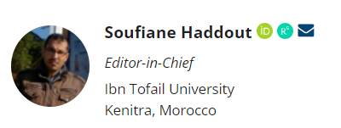
Estuarine Management and Technologies
https://emt.pensoft.net/
https://twitter.com/EstuarineMT

Slide 2
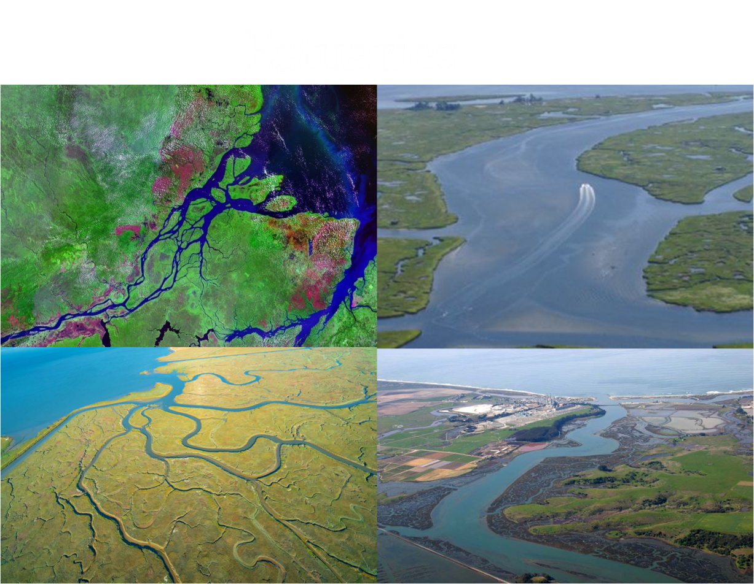
An estuary is a coastal area where freshwater from rivers and streams mixes with saltwater from the ocean. These environments are ecologically significant and support a diverse range of plant and animal species. They also play a crucial role in various ecological processes and serve as vital habitats for many species, including migratory birds and various fish species. Given the complexity and importance of estuaries, a journal with the name "Estuarine Management and Technologies (EMT)" may focus on the technological aspects of studying, managing, and conserving estuarine environments.
https://www.stateofourestuaries.org/

Slide 3
“Estuarine Management and Technologies” is established to facilitate the electronic publication of peer-reviewed papers encompassing all facets of estuarine management and technologies. The subjects suitable for publication cover a wide spectrum of disciplines, including physics, chemistry, geology, biology, and hydrology within this expansive system. We place a particular emphasis on papers that transcend individual technical domains, offering fresh and insightful perspectives on the attributes and management of this complex ecosystem.
Our publication achieves this objective by featuring peer-reviewed papers from accomplished colleagues at esteemed institutions worldwide, as well as vetted manuscripts from emerging professionals whose contributions showcase their rising careers within our community.
The majority of our content consists of original research articles and reports that, in a significant way, advance the comprehension and management of information resources within our area of expertise, tailored to their intended audience

Slide 4
Estuarine Management and Technologies accepts the following types of articles: Research Article, Review Article, Short Communication, Data Paper, Software Description, Editorial, Corrigendum, Methods & Technologies; Estuarine Scientists; Expert View; Video Paper in 180s; Rapid Communication; Mini-Review; Education & Communication. The publication in EMT is free of charge.
Estuarine scientists: i.e., a survey of the life, times, career and publication patterns of a distinguished scientist in the estuary area.
For the first time, we will be accepting a Video paper of 180 seconds. Some authors will be invited to create a short video lasting 180 seconds, which has not been presented or published before. This video will also undergo online evaluation by expert reviewers, along with the corresponding author and one member of the Editorial board in the respective field.

Slide 5
Specific research areas include:
Application of Remote Sensing and GIS technology in estuarine studies
Estuaries bio-resources systems
Monitoring, remediation, assessment and protection of estuaries
Planning and management of estuaries towards sustainability
Development and realization of national and international policies on estuaries
Estuaries economics
Contaminant sources, sorption, diffusion, transformation, volatilization and transport
Physics, chemistry, geology and biology of estuary
Estuarine pollution and control
Estuarine water quality assessment
Ecology and biodiversity of estuaries
Degradation of estuarine ecosystems and its abatement
Estuarine ecosystems maintenance and preservation
Estuary and coastal aquifer interactions
Micro(nano) plastic detection and remediation in estuaries
Climate change impacts on estuaries
Application of artificial intelligence in estuarine studies
Numerical and Analytical modelling of estuarine processes
Estuarine circulation
Estuarine sedimentary processes

Slide 6
Peer review
After undergoing an initial assessment for suitability by the editor, the paper will then undergo a thorough evaluation by two independent and anonymous experts in the field.
To assist authors in enhancing the overall quality of their journal articles, various scientific editing tools will be made available. These tools are designed to provide developmental editing, support, and feedback.
Authors are encouraged to utilize these resources to refine their manuscripts, particularly in addressing potential grammatical or spelling errors.
This rigorous review process and the availability of editing tools aim to ensure that the published articles in "Estuarine Management and Technologies" maintain a high standard of quality and clarity, ultimately contributing to the advancement of knowledge in the field.

Slide 7
The audience for “Estuarine Management and Technologies”
The audience for the Estuarine Management and Technologies is likely to be composed of professionals, researchers, and experts with special interests in the technological aspects of studying, managing, and conserving estuarine environments. This may include:
Researchers and Scientists; Environmental Engineers and Technologists; Civil Engineers and Technologists; Marine Biologists and Ecologists; Government Agencies and Policy Makers; Conservation Organizations; Academics and Educators; Students and Graduates; Consultants and Industry Professionals; Technology Developers and Innovators; International Organizations and NGOs.

Slide 8
Guest Editor Invitation
Being a Guest Editor for our journal (Estuarine Management and Technologies) comes with several benefits, both personally and professionally. Here are some of the advantages:
Expanded Network
Enhanced Visibility
In-Depth Knowledge
Editorial Experience
Contributing to the Field
Professional Development
Recognition by the Journal and Institution
Personal Fulfillment
Overall, being a Guest Editor can be a rewarding experience that offers both personal and professional growth opportunities. It's a role that comes with responsibilities, but the benefits can be substantial for your academic career and your contribution to the advancement of knowledge in your field.

Slide 9
Calling for nomination and application: Trailblazing Talent in Estuarine Management and Technologies (TteMt) award
The TteMt award serves as a beacon of encouragement and support for young scientists and engineers who are at the forefront of cutting-edge research in estuarine management and technologies. Estuaries, being critical transition zones where rivers meet the sea, play a pivotal role in coastal ecosystems and are essential for various ecological and economic activities. By focusing on interdisciplinary scientific work, the TteMt award recognizes the complex nature of estuarine systems, which require a multi-faceted approach to understand and manage effectively. This emphasis on collaboration across disciplines encourages a holistic perspective, allowing awardees to tackle the complex challenges facing estuarine environments.

Slide 10
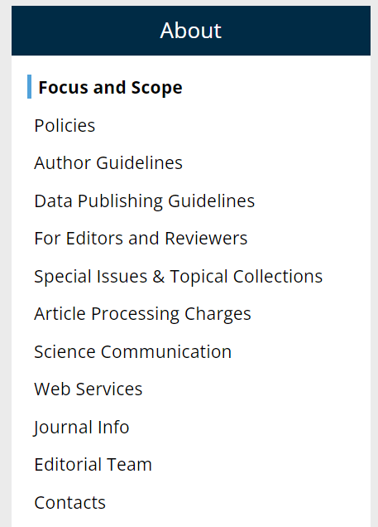
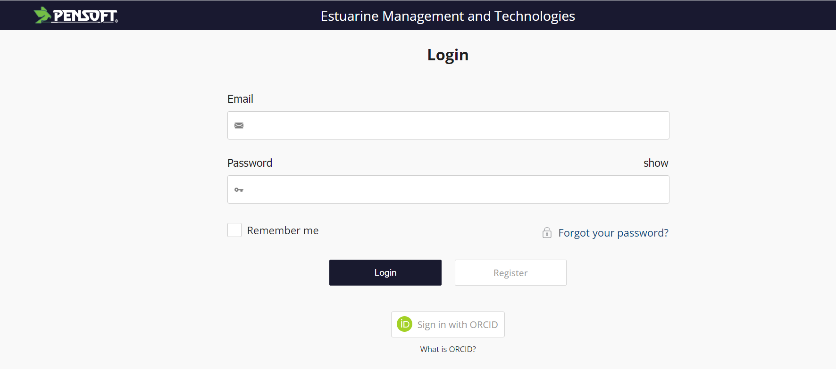
Journal Website
https://emt.pensoft.net/

Slide 11
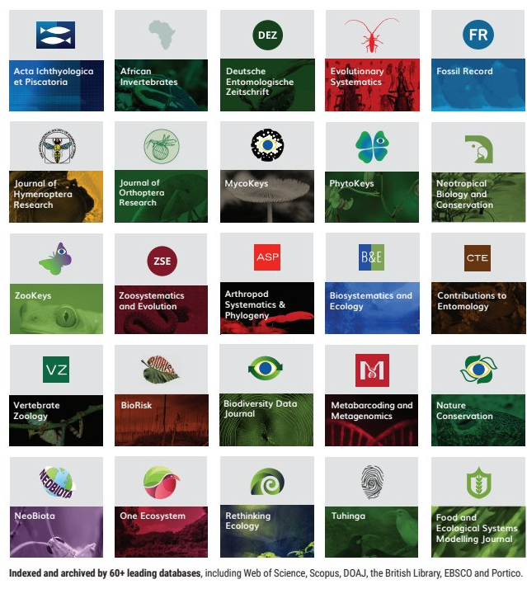
Pensoft Publishers
https://pensoft.net/

